Slide 1

Neurofeedback and Artificial Intelligence
• • • AI helps interpret complex brainwave patterns
• Goal: improve personalized brain training and treatment
Using EGGLAB software.
Resource: https://pmc.ncbi.nlm.nih.gov/articles/PMC4892319/#:~:text=Neurofeedback%20is%20a%20kind%20of,and%20providing%20a%20feedback%20signal.

Slide 2


What is Neurofeedback?
• A method that trains people to regulate their brain activity
• Brain waves are measured using EEG sensors on the scalp
• The system provides visual or audio feedback
• Users learn to adjust their brain activity through practice

Slide 3

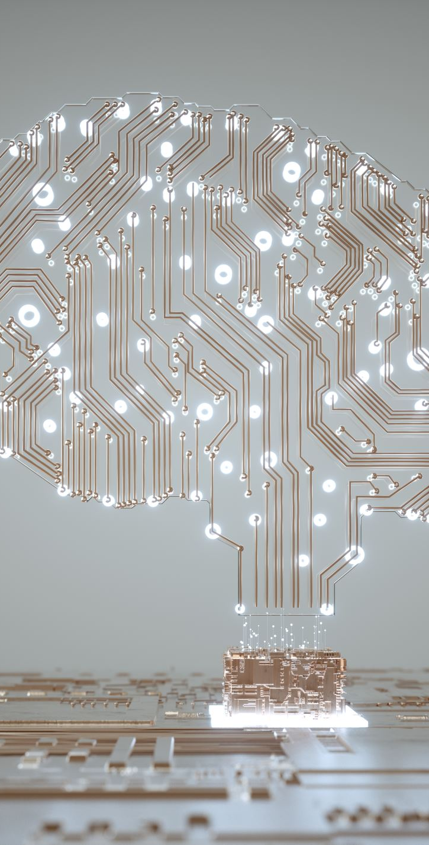

Why AI is Important in Neurofeedback
• AI can analyze large datasets much faster than humans
• Machine learning models identify hidden patterns in brain signals

Slide 4

Medical and Cognitive Applications
• ADHD – improving attention and focus
• Anxiety – helping regulate stress responses
• Depression – supporting emotional regulation
• Learning disorders – improving cognitive performance
• Research is ongoing to confirm long-term effectiveness

